Slide 1
UNIT II: STATIC ELECTRIC FIELDS
Presentation by
Dr. Rajasi Mandal
Assistant Professor
EEE
SSN College of Engineering

Slide 2
Session Objectives
  To study the concepts of electrostatic fields, electrical potential, energy density, Coulomb’s and Gauss’s laws, and their applications.

Slide 3
Session Outcomes
  Students will be able to explain and apply the concepts of static electric fields. (CO2)

Slide 4
Session Outline
  Force between two point charges: Coulomb’s Law
  Electric Field
  Electric Field Intensity or Electric Field Strength
  Concept of Conservative Field
  Electric Potential
  Electric Potential Difference
  Electric Potential Energy
  Concept of Equipotential Surface
  Interrelationship between E and V
  Line, Surface, and Volume Charge Densities
  Electric Flux
  Gauss’s Law in Electrostatics
  Applications of Gauss’s Law
  Poisson’s Equation and Laplace’s Equation
  Properties of Dielectrics
  Dielectric Polarization
  Calculation of Capacitance, Energy, Energy Density for Parallel Plate Capacitors

Slide 5
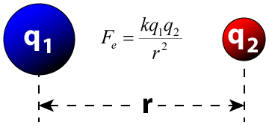
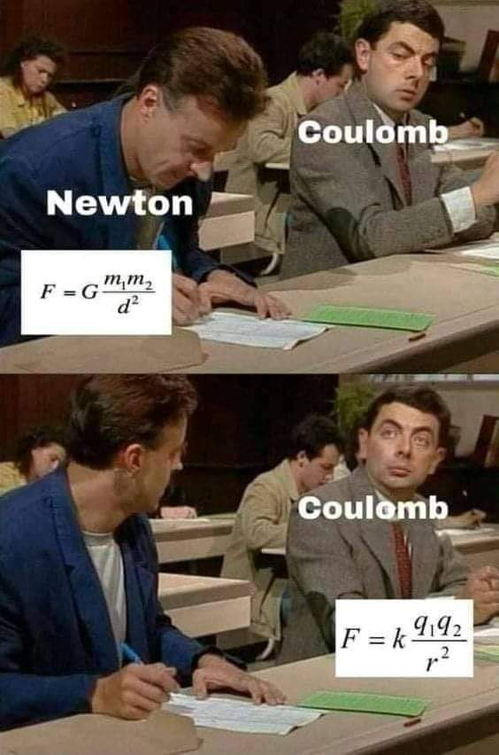
Force between two point charges: Coulomb’s Law
Coulomb’s Law gives the electric force between two point charges.
Where,
k=Coulomb’s constant=9x10⁹ Nm²/C²
q₁=point charge 1
q₂=point charge 2
r=the distance between the two charges
According to Coulomb's law, the force of attraction or repulsion between two stationary charges is directly proportional to the product of the magnitudes of the charges and inversely proportional to the square of the distance between the charges.
Practice Problem 1 Two charges 1μC and 2μC are separated by a distance of 1m. Calculate the force acting between the charges.

Slide 6
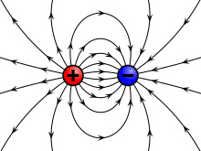

Electric Field
The space around the charge in which any other charge experiences a force is called an electrostatic field.
The electric field intensity E or the strength of an electric field at a given point is the force exerted on a unit positive charge placed at that point.
⸫ E=F/q
Electric Field Intensity or Electric Field Strength
Conservative Field
The electrostatic field is a conservative field.
The work done on the field is independent of the path followed.
The work done over a closed path is zero.
The curl of the electrostatic field is zero.
Practice Problem 2 Two charges 1C and 4C are placed at a distance 9m apart. At what distance from the 1C charge the electric field intensity will become zero?

Slide 7
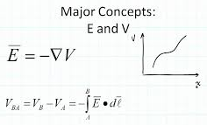
Electric Potential
The electric potential at a point in an electric field is defined as the amount of work done to bring a unit positive charge from infinity to that point against the electrostatic force.
Electric Potential Difference
NOTE:
The negative sign indicates that the direction of E is along the direction of decreasing V.
An equipotential surface is the locus of all the points on a surface with same potential.
Two equipotential surfaces can never intersect each other.
The electric field is always perpendicular on an equipotential surface.
The electric potential difference between 2 points A and B in an electric field is defined as the amount of work done to bring a unit positive charge from the point B to the point A against the electrostatic force.
Electric Potential Energy
The electric potential energy of a system of point charges is measured by the the amount of work done to bring a test charge or charges from infinity to that point against the electrostatic force to form the system.

Slide 8
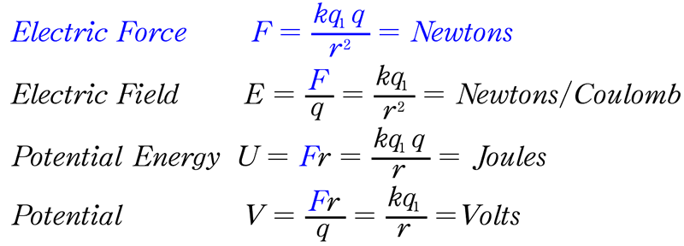
Formulae: Electric Force, Electric Field, Electric Potential, Electric Potential Energy
Practice Problem 3 The electric potential at a distance 2m from a point charge is 200V. Find the charge.
Practice Problem 4 The potential of 2 points in an electric field are 400V and 1000V respectively. What work must be done to move a positive charge of 3x10⁻¹⁸ C from one point to another?
Practice Problem 5 3 point charges +q, +2q, and mq are placed at the 3 corners of an equilateral triangle of side ‘a’. Find the value of ‘m’ for which the potential energy of the system becomes zero.

Slide 9
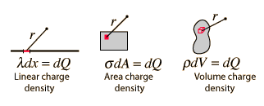
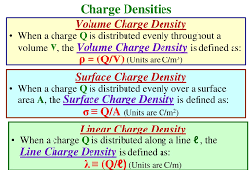
Line, Surface, and Volume Charge Densities

Slide 10
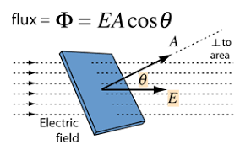
Electric Flux
The total number of lines of force passing through a surface placed in an electric field is called the electric flux.
Practice Problem 6 Find the electric flux through the surface vector S=5j in a region of an electric field E=9i+j+2k.
Practice Problem 7 The electric in a region is E=2i+3j+k. Find the electric flux through the surface area of 50 square units in X-Y plane.

Slide 11
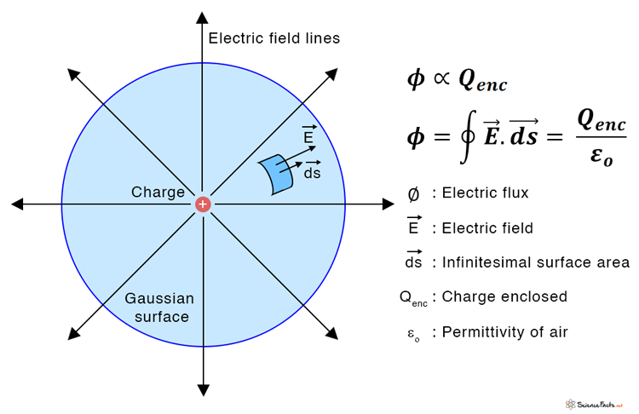
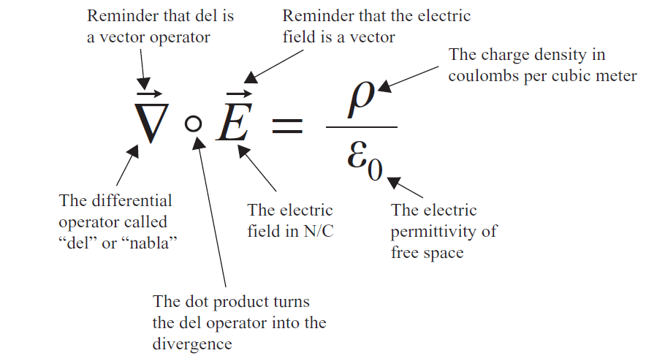
Gauss’s Law in Electrostatics
Integral Form
Differential Form
Gauss's law in electrostatics states that the electric flux ϕ through any closed surface is equal to (1/ε₀) times the net charge q enclosed by the surface.
Therefore, ϕ = q/ε₀
Where, ε₀ is the electric permittivity of free space and ε₀ has a value of 8.854 × 10^{–12} C² N⁻¹ m².
The surface integral of electric field over a closed surface is equal to (1/ε₀) times the net charge enclosed by the surface.
The divergence of electric field at any point is equal to (1/ε₀) times the volume charge density at that point.

Slide 12
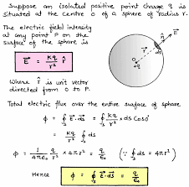
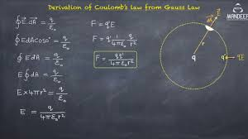
Proof of Gauss’s Law in Electrostatics
Derivation of Coulomb’s Law from Gauss’s Law
Gaussian Surface: Gaussian surface is an imaginary closed surface constructed for finding electric field intensity using Gauss’s law. The magnitude of the electric field intensity is same on each point on the Gaussian surface and the direction of electric field is normal to the Gaussian surface.

Slide 13
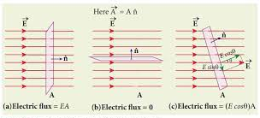
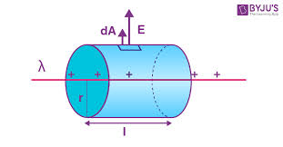
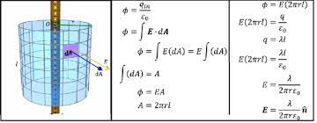
Applications of Gauss’s Law:
Electric field due to an infinitely long uniformly charged wire

Slide 14
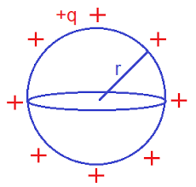
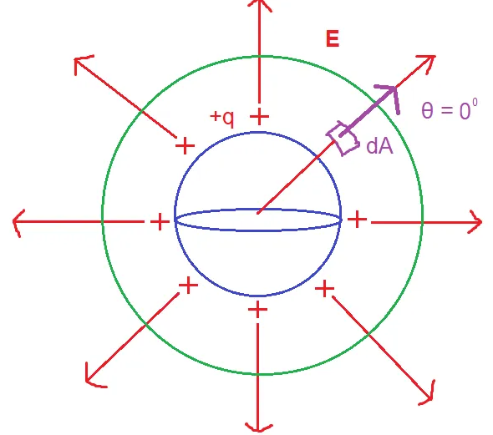
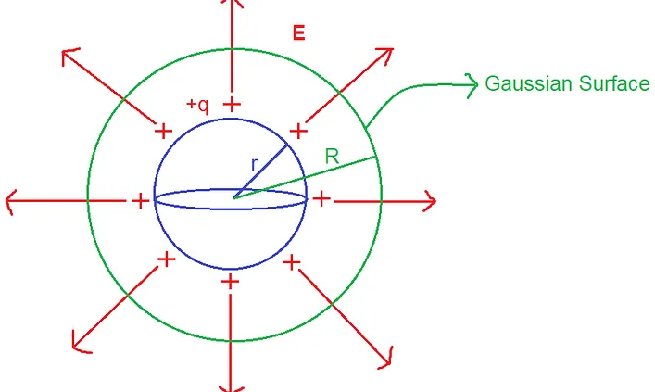
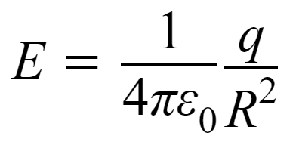
Applications of Gauss’s Law:
Electric field due to a hollow sphere of radius r
Case- I Electric Field Outside The Surface Of The Sphere (R > r)
The outer spherical surface is our Gaussian Surface. The net charge inside the Gaussian surface , Σq = +q .
According to Gauss’s Law, φ = q/ε₀ .
Again, φ = ∮E . dA [dot product of E and dA]
or, φ = ∮E*dA*cos θ
Hence, q/ε₀ = ∮E*dA*cos θ
E will be constant in all equidistant places from the center.
As both the direction of dA and E are the same(radially outwards). So, the angle between them i.e. θ is always 0⁰.
q/ε₀ = E ∮dA * cos 0⁰ = E ∮dA * 1 = E ∮dA
Now, ∮dA is the surface area of the outer sphere .
So, ∮dA = 4πR²q/ε₀ = E * 4πR²
Therefore,

Slide 15
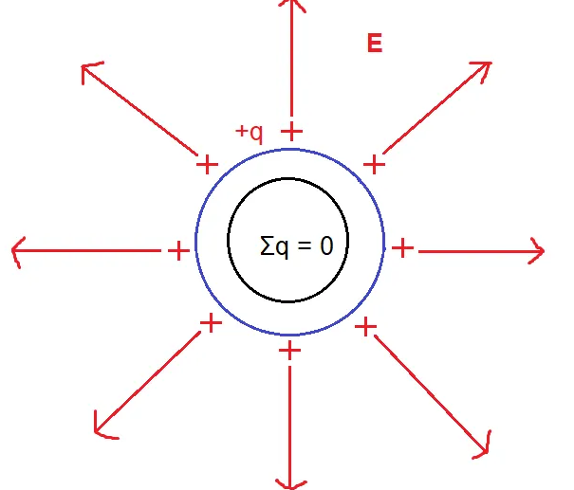
Applications of Gauss’s Law:
Electric field due to a hollow sphere of radius r
Case- II Electric Field Inside The Surface Of The Sphere (R < r)
If we assume any hypothetical sphere inside the charged sphere, there will be no net charge inside the Gaussian surface . So, Σq = 0 .
So, the net flux φ = 0.
So, ∮E*dA*cos θ = 0
or, E ∮dA*cos θ = 0
or, E = 0
So, the electric field inside a hollow sphere is zero.
Practice Problem 8 Derive an expression for the electric field intensity at a distance r from the centre: (a) for a solid cylinder and (b) for a solid sphere.

Slide 16
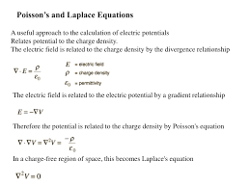

Poisson’s Equation and Laplace’s Equation
Derivation
Practice Problem 9 Check whether the following potential functions satisfy Poisson’s equation or Laplace’s equation. Also, if any equation satisfies Poisson’s equation then find the volume charge density.
(i) V(x,y,z)=(x²-y²-z),
(ii) V(x,y)=(x²+y²).

Slide 17
Properties of Dielectrics
Conductor is a substance that conducts electricity whereas Dielectric is a non-conducting substance with a large energy-gap, high specific resistance, a high insulating resistance, and a negative temperature coefficient of resistance.
Dielectrics can hold electrical charges.
Examples of dielectric are Mica, Plastics, Glass, Porcelain and Various Metal Oxides.
Dielectric strength: Dielectric strength is the maximum electric field that a dielectric material can withstand without breaking down and becoming conductive.
Types of Dielectrics:
  Solid Dielectrics – Ceramic, Plastic, Mica, and Glass.
  Dielectric Liquid – Distilled Water.
  Dielectric Gas – Dry Air, vacuum, nitrogen and helium.
Applications of Dielectrics: Power cables, Capacitors, etc.

Slide 18
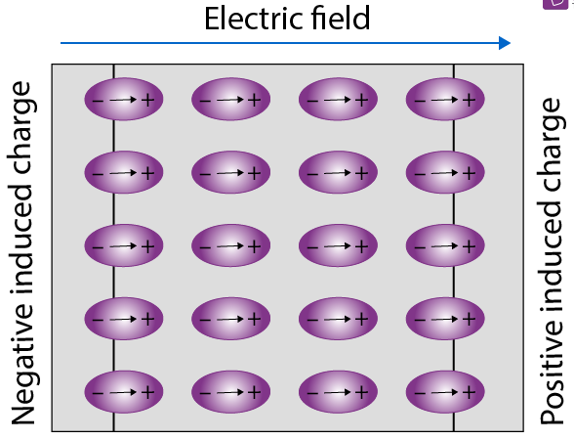
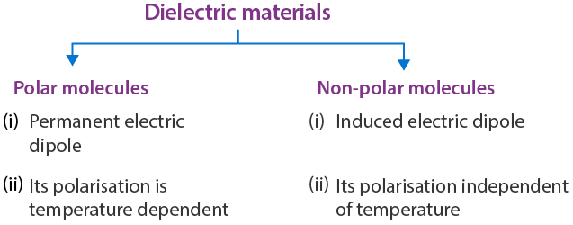
Dielectric Polarization
A dielectric may be made up of polar or non-polar molecules. But the net effect of an external field is almost the same, i.e., the external field will compel the molecules to align their dipole moments along its own direction.
During polarization of dielectric, the positive charges move in the direction of the field, and the negative charges move in the opposite direction. In other words, the electric dipoles align themselves with the direction of the field. In this state, the entire dielectric and its molecules are said to be polarised.
The alignment of the dipole moments of the permanent or induced dipoles with the direction of the applied electric field is called polarisation.
Polarisation can thus also be thought of as a phenomenon in which an alignment of positive and negative charges takes place within the dielectric, resulting in no net increase in the charge of the dielectric.
Polarisation vector is defined as the electric dipole moment per unit volume. Polarisation vector has the same direction as dipole moment. The unit of this polarization vector is C/m³.

Slide 19
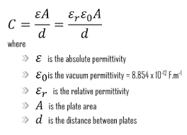
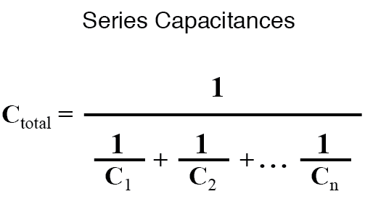
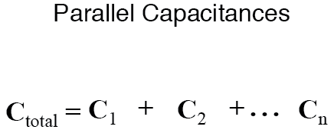
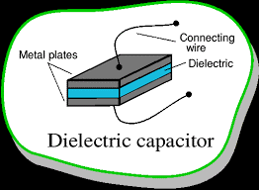
Capacitance of a Parallel Plate Capacitor
Charge (Q) = Capacitance, C × Voltage, V.
Energy, U = ½ C V². .
Energy Density, U = ½ ε E².
Energy Density is defined as the total amount of energy in a system per unit volume.

Slide 20
Test Your Understanding
State and derive Gauss’s law in Electrostatics. Using the Integral form of Gauss’s law, derive the Differential form of Gauss’s law.
State Coulomb’s law in Electrostatics.
Derive the Poisson’s equation and Laplace’s equation in Electrostatics.
Calculate the electric field intensity and electrostatic potential at a distance, r for a hollow sphere of radius, R and carrying a charge, Q for:
    r<R,
    r=R,
    r>R.
  Also, plot a graph showing how the electric field intensity and the electrostatic potential varies with the distance, r.
Three concentric spherical shells of radii 2r m, 4r m, and 8r m carry uniform surface charge densities of σ₁=20nC/m², σ₂=-4nC/m², and σ₃=-0.25nC/m², respectively. Calculate the magnitude of the electric field intensity at a distance 10r m from the center of the concentric shells.
The electrostatic potential function in free-space is given by, V(x,y,z)=50x²+50y²+50z². Find the magnitude of electric field intensity at (1,-1,1).
A point charge of 1μC is placed in space as shown in the figure. Find the potential difference, V_{PQ}.
Find the energy density of a capacitor if its electric field, E = 5 V/m.
Q
20mm
P
1μC
40mm
NOTE:- No need to submit this.

Slide 21
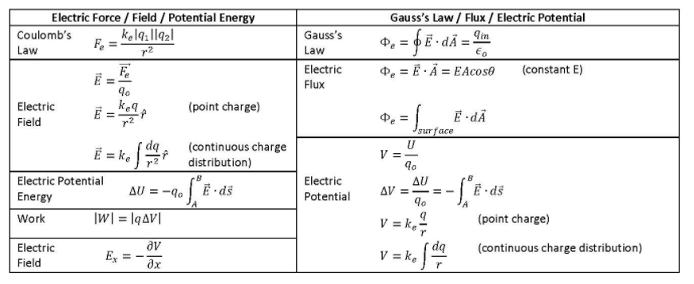
Summary

Slide 22
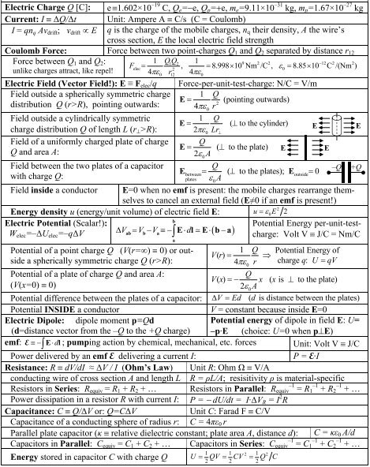
Summary

Slide 23
References
A Text Book on Classic Engineering Physics, Amal Kr. Chakrabarty.
Engineering Electromagnetics, William H. Hayt, Jr., John A. Buck.
Field and Wave Electromagnetics, David K. Cheng, Pearson New International Edition.
Elements of Electromagnetics, Matthew N. O. Sadiku, Oxford University Press.
Electromagnetic Waves and Radiating Systems, Edward C. Jordan, Keith G. Balmain, Prentice-Hall Inc.

Slide 24
Thank you !

